Slide 1
Summer 2024 wrap up

Slide 2
3 gene 4 node toy network overview
Previous 3 gene 4 node networks have shown that weight estimation is greatly improved when the p values are help constant
  Typically, estimation is best for trials where p’s and b’s are held constant followed by a slight increase in error when just p is held constant
5 more runs were conducted to confirm whether this was the case
  Between all runs the percent error where there are no constants or only b is constant is higher than when p or p and b are constant
Average percent errors:
  P and b constant – 20.1426%
  P constant – 17.97411%
  B constant – 74.64131%
  No constants - 51.25387%

Slide 3
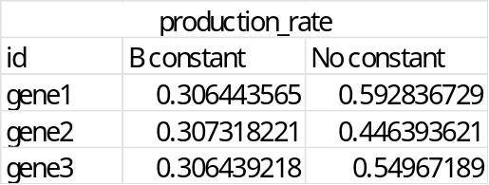
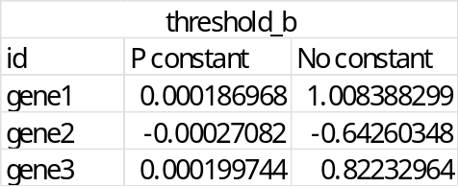
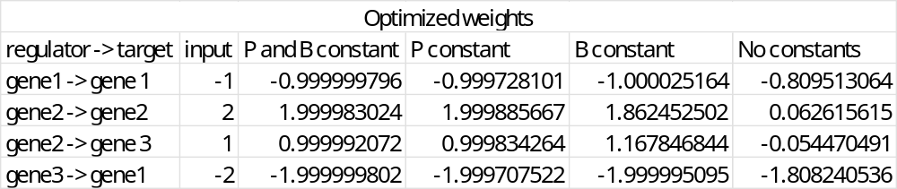
Trial 7 – output follows expected trends
gene1
gene2
gene3

Slide 4
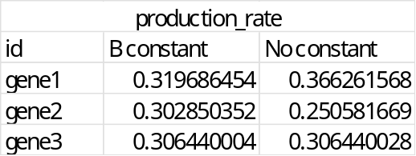
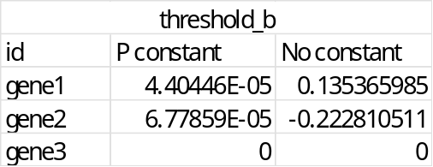
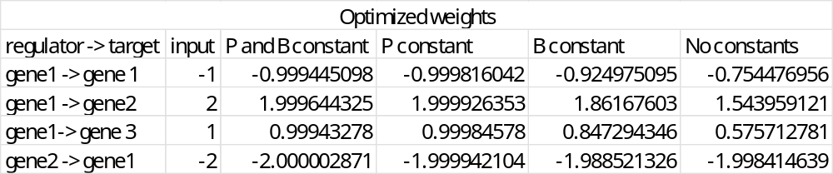
Trial 4 – output generally follows expected trends
Interestingly for this trial, the estimated weights where only P was held constant were slightly better than when both P and B were held constant
  Average % error for P and B constant - 0.032534866%
  Average % error for P constant - 0.010098725%
Despite that slight variance, this trial followed what had been seen in the past
gene1
gene2
gene3

Slide 5
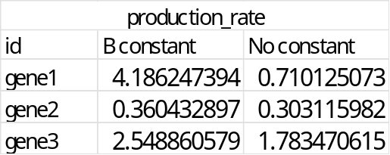
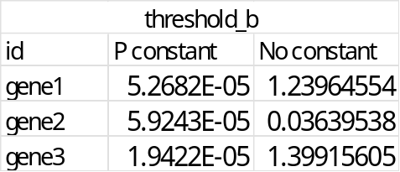
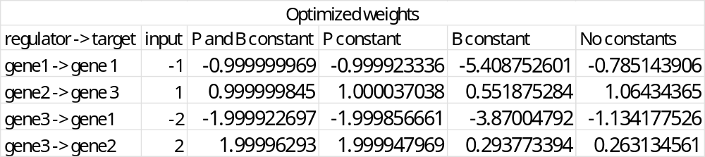
Trial 8 – output inconsistent for constant B run
For this trial, the percent error did increase once P was being estimated which is what we expected
The estimated for the run with a constant B gave production rate and weight outputs that were significantly different than what was expected
  The runs where there were no constants gave better outputs which has not been true for previous trials
gene1
gene2
gene3

Slide 6
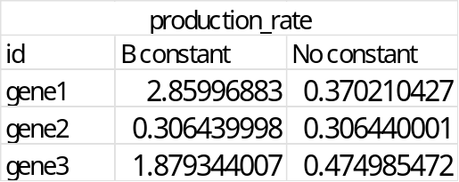
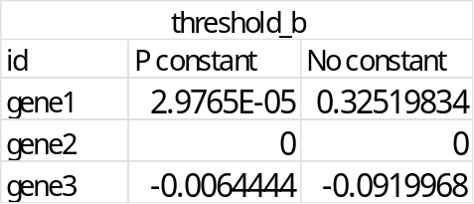
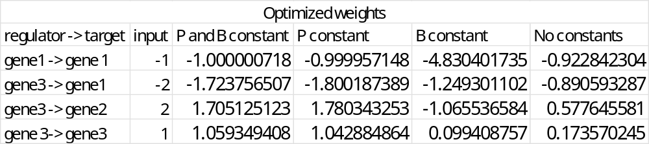
Trial 9 – output inconsistent between runs
For this trial, the percent error did increase once P was being estimated which is what we expected
Between the output got P and B constant and just P constant, the estimated weights for the latter were closer to the expected weights
Between the output for B constant and no constants, the estimated weights for the latter were closer to the expected weights
gene1
gene2
gene3

Slide 7
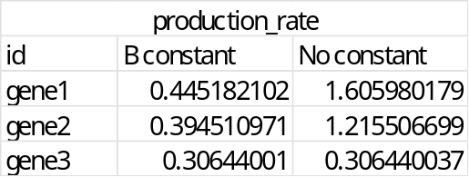
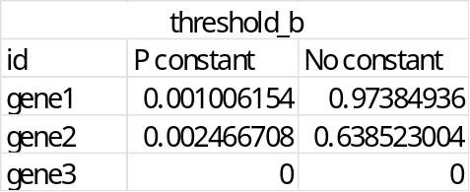
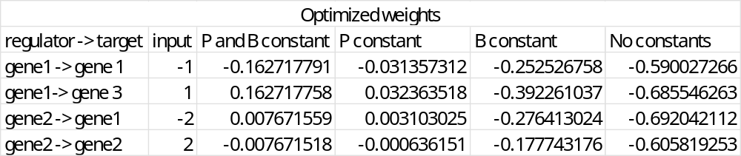
Trial 5 – output inconsistent for all runs
For this trial, the percent error did increase once P was being estimated which is what we expected
The estimates for all of the runs of this network were very different than the expected output
gene1
gene2
gene3

Slide 8
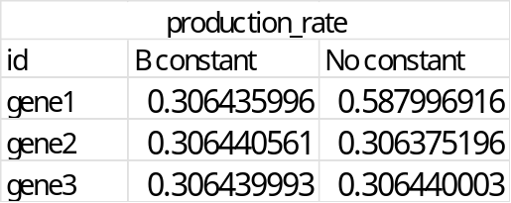
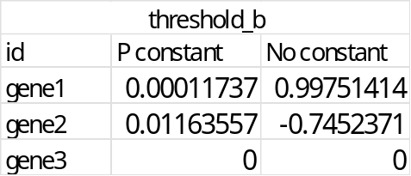
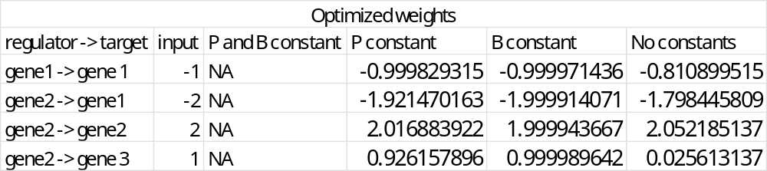
Trial 6 – output inconsistent for all runs
The run where B was held constant was the most accurate
The run where P was held constant took 26,801,500 iterations to complete and over 24 hours
  I waited 2 hours for the P and B constant run, and it didn’t finish so I was not able to complete that one
All the optimization parameters were the same as the other runs and the B constant and no constant runs had no problems, so I really don’t know what was going on for this one
gene1
gene2
gene3

Slide 9
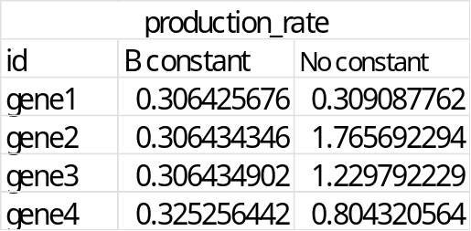
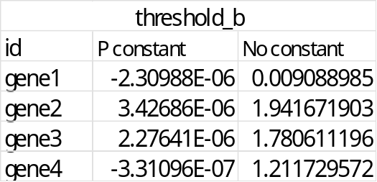
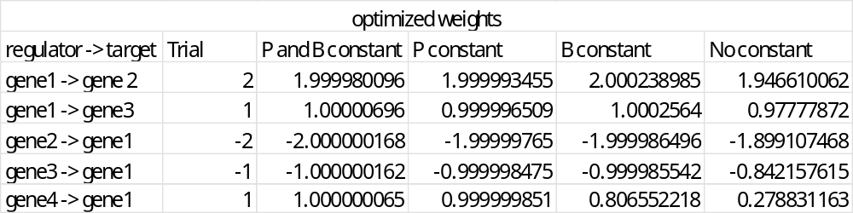
4 gene 5 edge network – trial 1
gene1
gene2
gene3
gene4

Slide 10
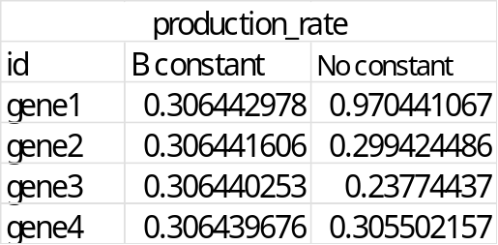
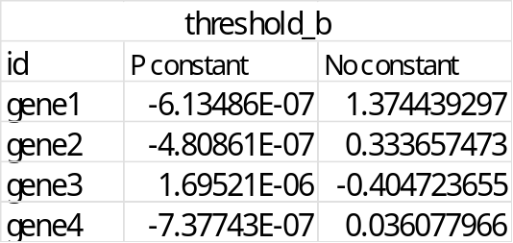
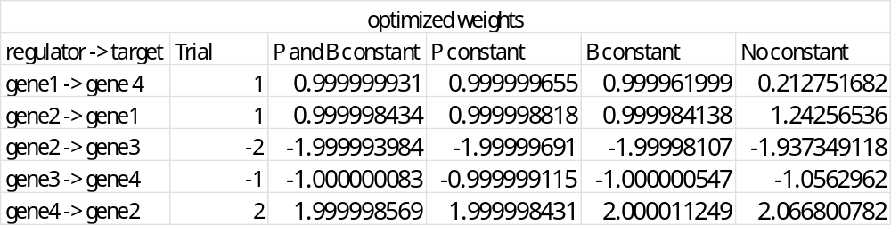
4 gene 5 edge network – trial 2
gene1
gene2
gene3
gene4

Slide 11
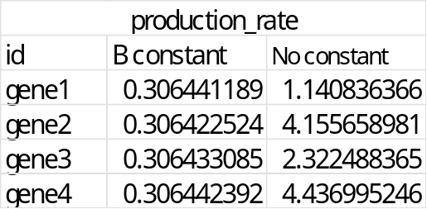
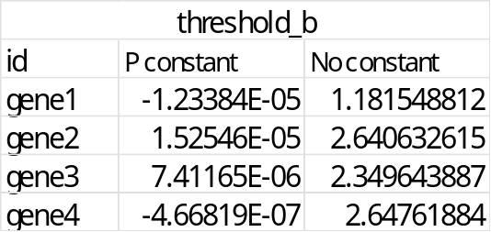
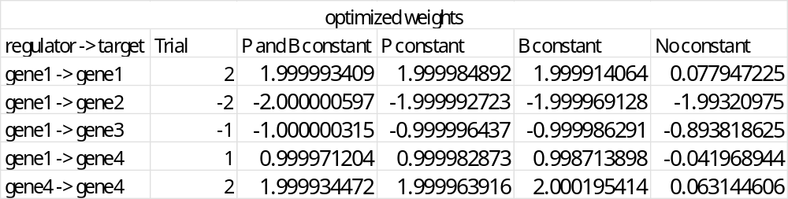
4 gene 5 edge network – trial 3
gene1
gene2
gene3
gene4

